Slide 1
Lecture 1
Introduction
National University of
Computer & Emerging Sciences

Slide 2
Dishonesty, Plagiarism
You can fool some of the people all of the time,
and all of the people some of the time,
but you can not fool all of the people all of the time.
Abraham Lincoln,
16th president of US (1809 - 1865)

Slide 3
Tentative Evaluation Breakdown
Assignments | 15
Quizzes | 05
Project | 15
Sessional | 25
Final | 40
Total | 100

Slide 4
Course outline
Introduction
OS Architectures and OS Services
Processes,
inter-process communication,
Threads
CPU Scheduling
Synchronization,
Semaphores,
Deadlocks
Memory and File-system management
…

Slide 5
Books
Text Book:
  Operating System Concepts, 8th Editon, Silberschatz Galvin Gagne
Reference Books:
  Modern Operating Systems, 2nd Edition, Andrew S. Tanenbaum
  Operating Systems, 4th Edition, William Stallings

Slide 6
Grading policy
Absolute grading

Slide 7
What is an Operating System?
It is a program!
Top-down view
  Provides an extended or virtual machine abstraction to user programs
    Easier to program than the underlying hardware.
    All services are invoked and accomplished through system calls.
Bottom-up view
  Acts as a resource manager of a complex system
  Resources consist of processors, memories, timers, disks, keyboard, network interfaces, printers etc.
  OS manages allocation of these resources to user programs in an orderly and controlled manner

Slide 8
What is an Operating System?
OS do nothing by themselves.
Similar to subroutine libraries, do nothing unless they are invoked by programs
Act as an intermediary between users and the hardware

Slide 9
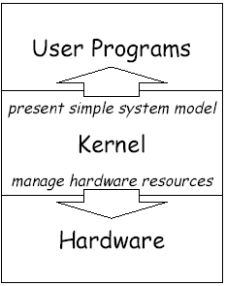
Two Goals of Operating Systems
Manage hardware resources
  System operates smoothly: efficiently, reliably, securely
Present abstract system model to programmer
  Simple and convenient access to and control of resources

Slide 10
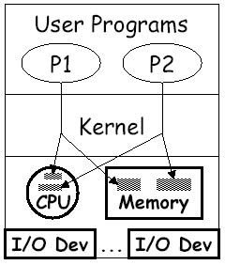
Manager/Coordinator of Resources
Coordinates who gets what
  “who”: running programs
  “what”: resources
  “when”: scheduling time
  “where”: organizing space
  “whether”: limits, rights
Goal: smooth system operation
  efficiency,reliability,security

Slide 11
Resource multiplexing
OS multiplexes resources in two ways:
In time
  Time multiplexing involves different programs taking turns in using the resource.
    Example: CPU scheduling
    printer sharing.
In space
  Space multiplexing involves different program getting part of the resource possibly at the same time.
    Example: memory is divided into several running programs.

Slide 12
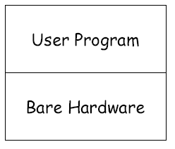
What If No Operating System?
All we have is bare hardware
You want to run a program
  How do you load it?
  How do you run it?
  What happens when it completes?
Need at least some minimal OS to do these functions

Slide 13
…Lets go back to the “stone age” of computing…

Slide 14
Early Systems
No Operating systems,
your Data and your Programs
  X = X + 1;
As
  Load Register1, x
  Load Direct Register2, 1
  Add Register3, Register2, Register1
  Store Register3, x
Time slots allocated to scientists
Enter programs using binary switches

Slide 15
Early Systems
Problem:
  computer idles while programmer sets things up.
  Poor utilization of huge investment.
Solution:
  Hire a specialized person to do setup.
Problem:
  Faster than programmer, but still a lot slower than the machine.
Solution:
  Build a batch monitor.

Slide 16

The Monitor
Early batch system
  bring cards to 1401
  read cards to tape
  put tape on 7094 which does computing
  put tape on 1401 which prints output

Slide 17
Simple Batch System
The user submits a job (written on a card or tape) to a computer operator.
The computer operator place a batch of several jobs on a input device
A special program, the monitor, manages the execution of each program in the batch
Resident monitor is in the main memory and available for execution

Slide 18
The Monitor
Monitor reads job one at a time from the input device
Monitor places a job in the user program area
A monitor instruction branches to the start of the user program
Execution of the user program continues until:
  End of program occurs
  Error occurs

Slide 19
What is an Operating System?
A program that acts as an intermediary between a user of a computer and the computer hardware
Operating system goals:
  Execute user programs and make solving user problems easier
  Make the computer system convenient to use
  Use the computer hardware in an efficient manner

Slide 20
Why study operating systems?
Point of describing change isn’t “Look how stupid batch processing is” – it was right for tradeoffs of the time, but not anymore
Point is: have to change with changing technology
Situation today is much like it was in the late 60’s OS’s today are enormous, complex things
  100k's of lines (or >1M lines)
  Windows NT is 20M lines
  Windows2000 and Windows XP are about 40M lines.
Key aspect of this course, understand OS’s so we can simplify them!

Slide 21
What Operating Systems Do
Depends on the point of view
Users want convenience, ease of use and good performance
  Don’t care about resource utilization
But shared computer such as mainframe or minicomputer must keep all users happy
Users of dedicate systems such as workstations have dedicated resources but frequently use shared resources from servers
Handheld computers are resource poor, optimized for usability and battery life
Some computers have little or no user interface, such as embedded computers in devices and automobiles

Slide 22
Operating System Definition
OS is a resource allocator
  Manages all resources
  Decides between conflicting requests for efficient and fair resource use
OS is a control program
  Controls execution of programs to prevent errors and improper use of the computer

Slide 23
Computer Startup
bootstrap program is loaded at power-up or reboot
  Typically stored in ROM or EPROM, generally known as firmware
  Initializes all aspects of system
  Loads operating system kernel and starts execution

Slide 24
Beyond batch processing systems
The Era of Timesharing and Multiprogramming
Multiprogramming - Execute multiple jobs simultaneously
Timesharing - Processor’s time is shared among multiple users

Slide 25
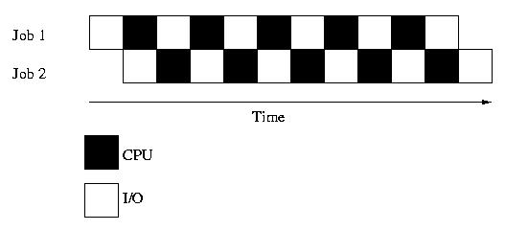
Multiprogramming
Execute multiple jobs simultaneously
But a CPU can execute a single instruction at a time???
One job can use the CPU while the other is waiting for I/O
Small jobs not delayed by large jobs
Context switching

Slide 26
Time Sharing System (TSS)
Processor’s time is shared among multiple users
Use cheap terminals to let multiple users interact with the system at the same time.
OS does timesharing to give illusion of each user has own computer

Slide 27
I/O Structure
After I/O starts, control returns to user program only upon I/O completion
  Wait instruction idles the CPU until the next interrupt
  Wait loop (contention for memory access)
  At most one I/O request is outstanding at a time, no simultaneous I/O processing
After I/O starts, control returns to user program without waiting for I/O completion
  System call – request to the OS to allow user to wait for I/O completion
  Device-status table contains entry for each I/O device indicating its type, address, and state
  OS indexes into I/O device table to determine device status and to modify table entry to include interrupt

Slide 28
Operating System Structure
Multiprogramming (Batch system) needed for efficiency
  Single user cannot keep CPU and I/O devices busy at all times
  Multiprogramming organizes jobs (code and data) so CPU always has one to execute
  A subset of total jobs in system is kept in memory
  One job selected and run via job scheduling
  When it has to wait (for I/O for example), OS switches to another job
Timesharing (multitasking) is logical extension in which CPU switches jobs so frequently that users can interact with each job while it is running, creating interactive computing
  Response time should be < 1 second
  Each user has at least one program executing in memory process
  If several jobs ready to run at the same time  CPU scheduling
  If processes don’t fit in memory, swapping moves them in and out to run
  Virtual memory allows execution of processes not completely in memory

Slide 29

Memory Layout for Multiprogrammed System

Slide 30
Personal Computing
Computers are cheap, so give everyone a computer.
Initially, OS became a subroutine library again (MSDos)
Since then, adding back in memory protection, multiprogramming, etc.
Because when humans are expensive, don’t waste their time by letting programs crash each other

Slide 31
Distributed Computing
Computers so cheap – give people a bunch of them
  I have a 2 PCs at home, 1 in my office, 3 smart phones and share some machines in a lab how do I coordinate a bunch of machines?
Networks fast – allow machines to share resources and data easily
Networks cheap – allow geographically distributed machines to interact

